Slide 1


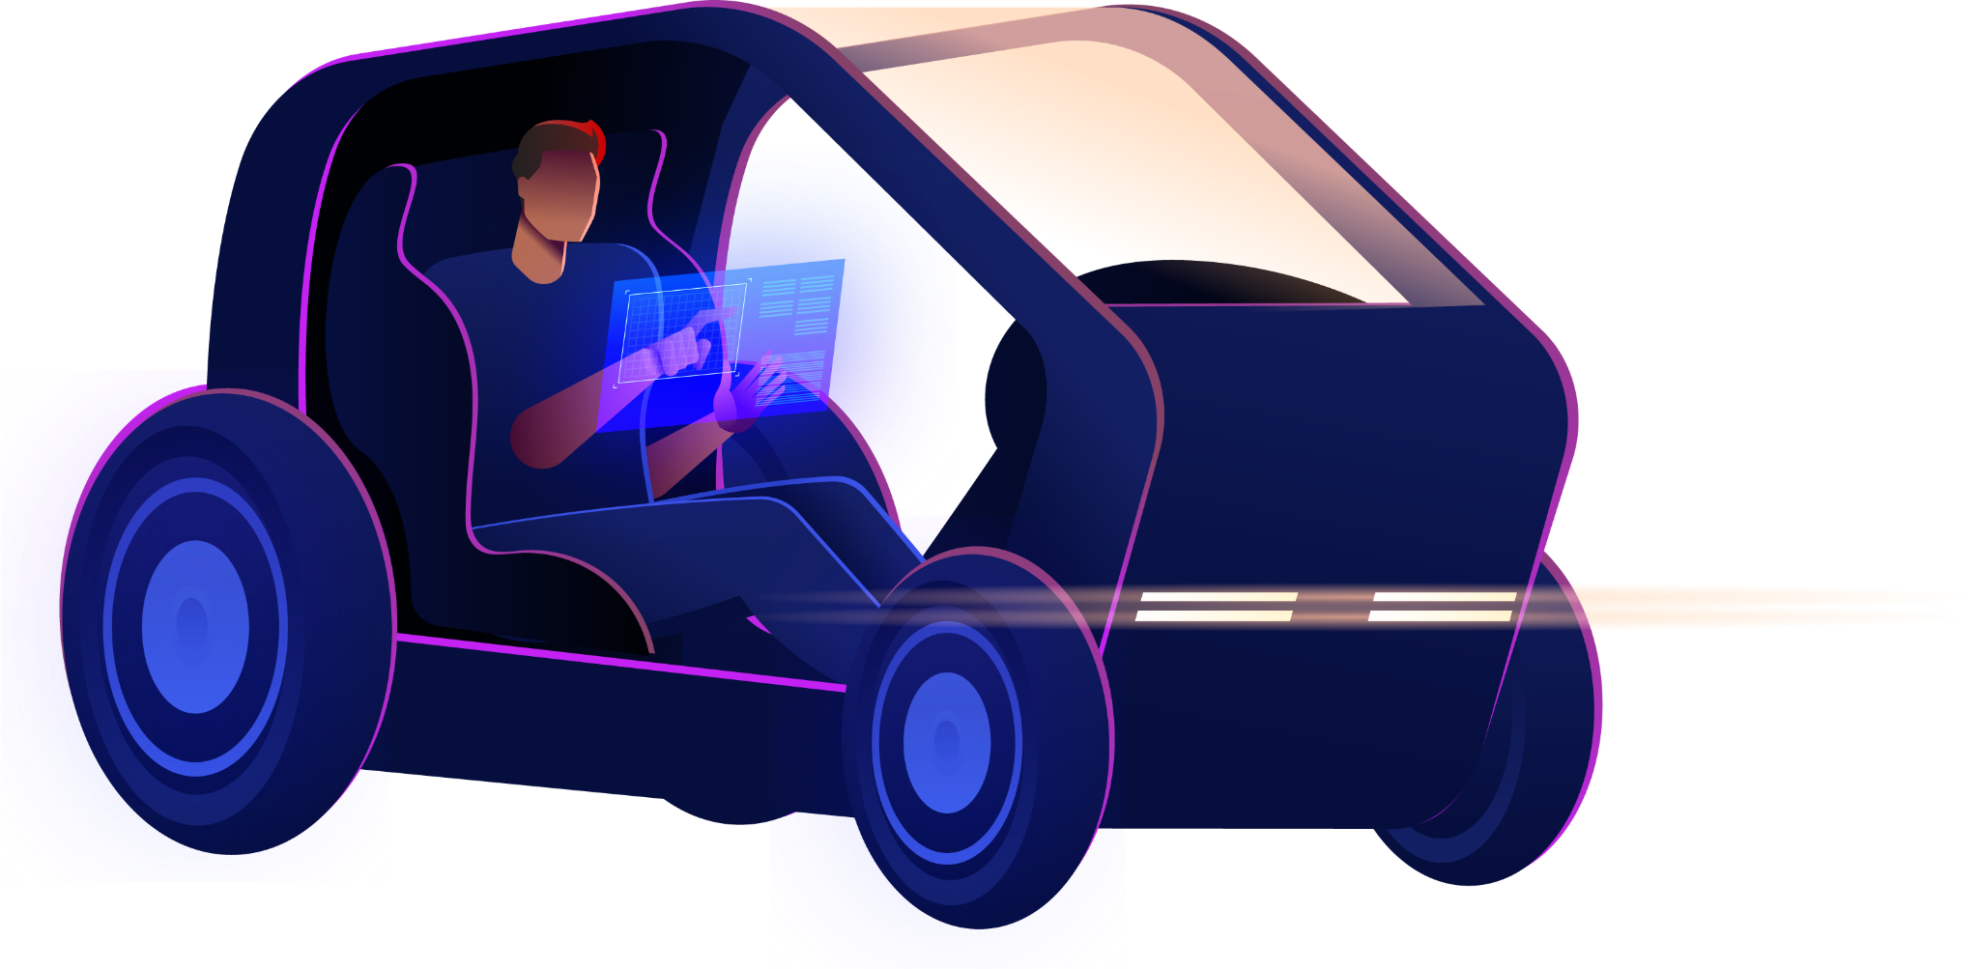


AVEIRO TECH CITY LIVING LAB
DIGITAL TWIN
Bernardo Pinto · Filipe Obrist · José Mendes · Mariana Perna · Rafaela Dias
Advisors: Susana Sargento, Pedro Rito, Filipe Cabral Pinto, Duarte Raposo

Slide 2

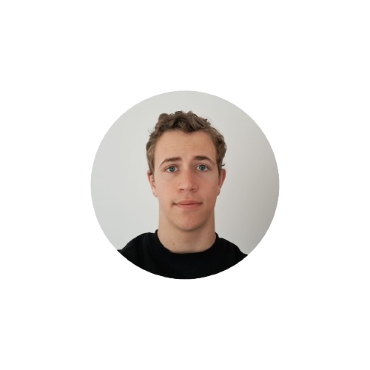

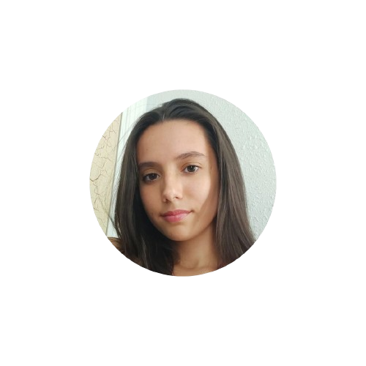
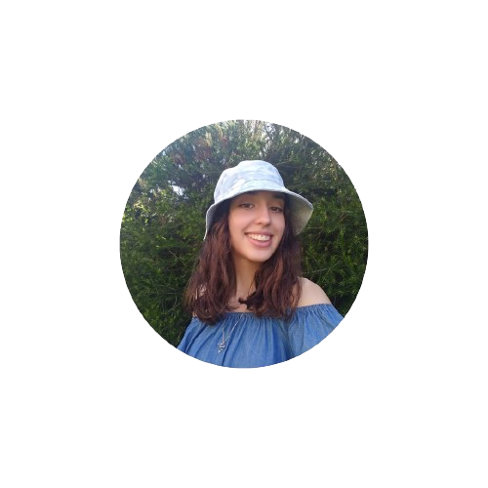
OUR TEAM
Bernardo Pinto
Filipe Obrist
José Mendes
Mariana Perna
Rafaela Dias

Slide 3

TABLE OF CONTENTS
01
04
02
05
03
06
Context
Work Done
State of Art
Prototype / Demo
Architecture
Future Work

Slide 4


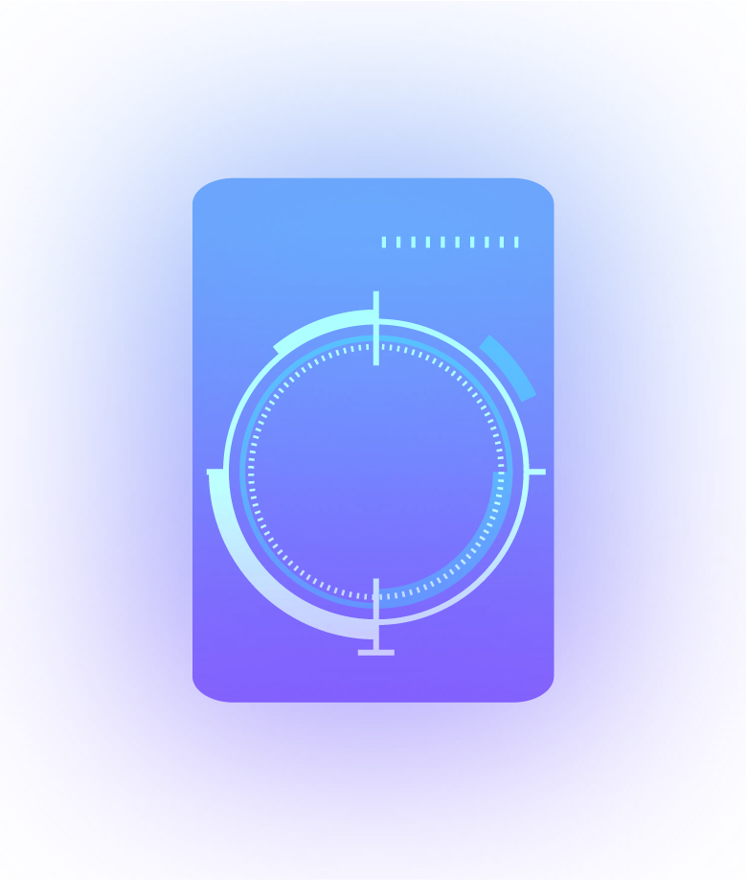
01
CONTEXT

Slide 5
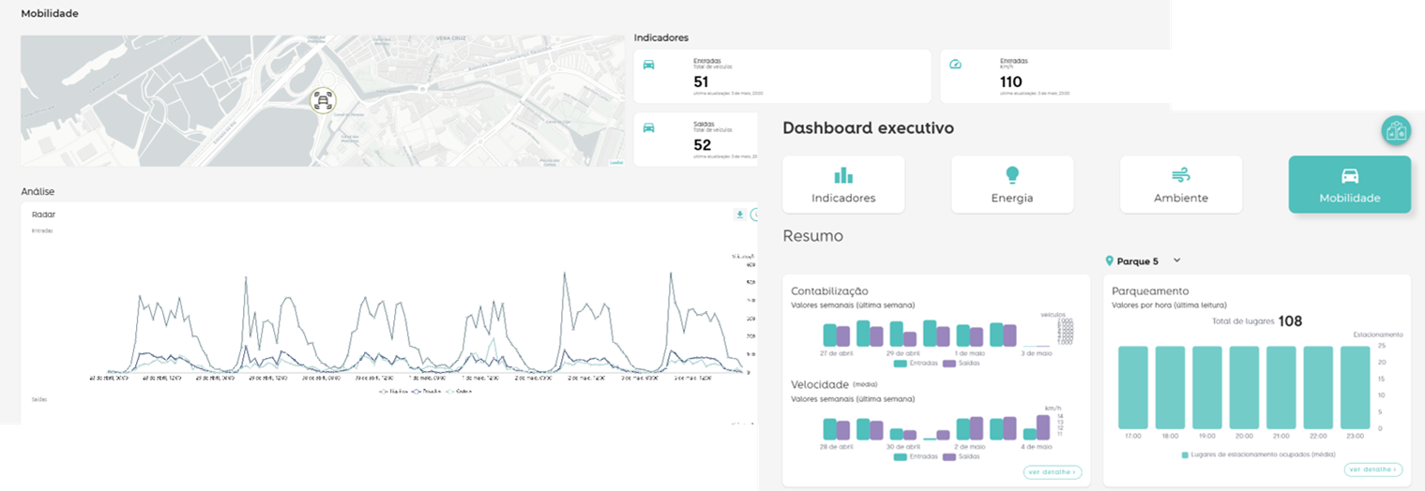
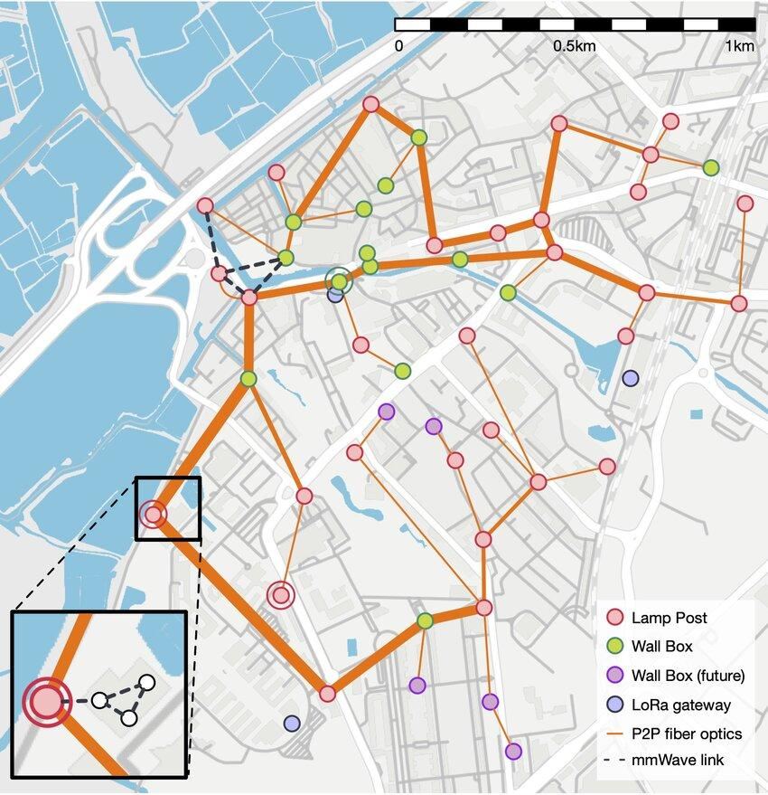
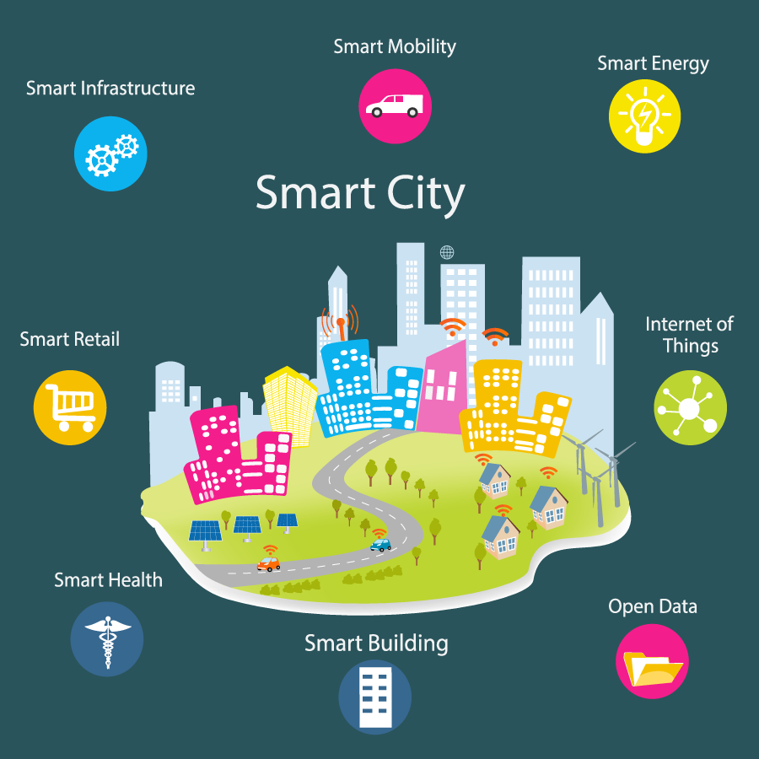
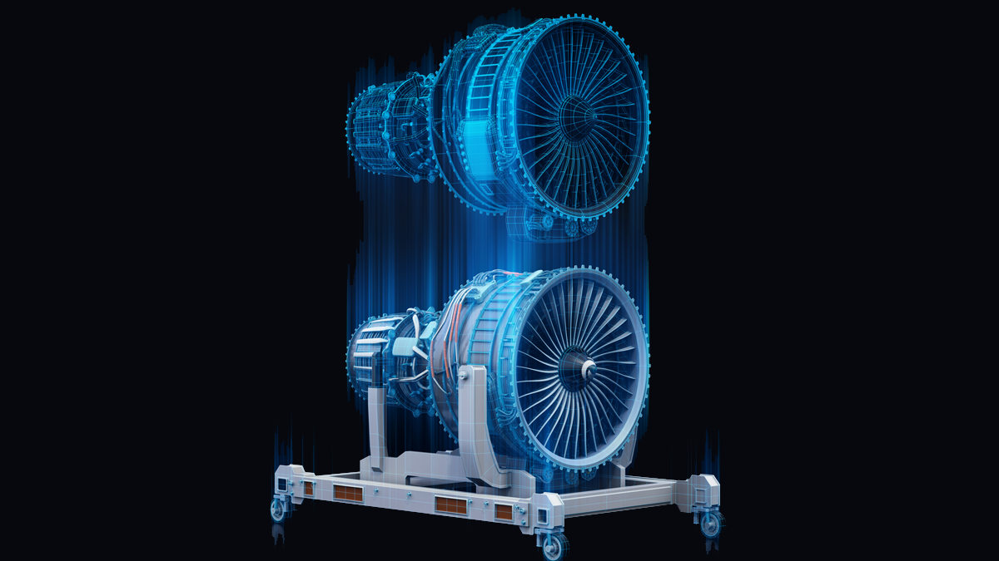

CONTEXT
SmartCities
Digital Twin
Aveiro Tech City Living Lab (ATCLL)
https://aveiro-living-lab.it.pt/citymanager
Live!Urban

Slide 6

02
STATE OF ART

Slide 7
STATE OF ART
Building a Motorway Digital Twin in SUMO
Smart Mobility Digital Twin for Automated Driving
Efficient Procedure of Building University Campus Models for Digital Twin Simulation
Real-Time Simulation of Continuous Data Stream from Traffic Counters
Design and Proof-of-Concept
https://ieeexplore.ieee.org/document/9913679
https://ieeexplore.ieee.org/document/10200728
https://ieeexplore.ieee.org/document/9899796

Slide 8
03
ARCHITECTURE

Slide 9
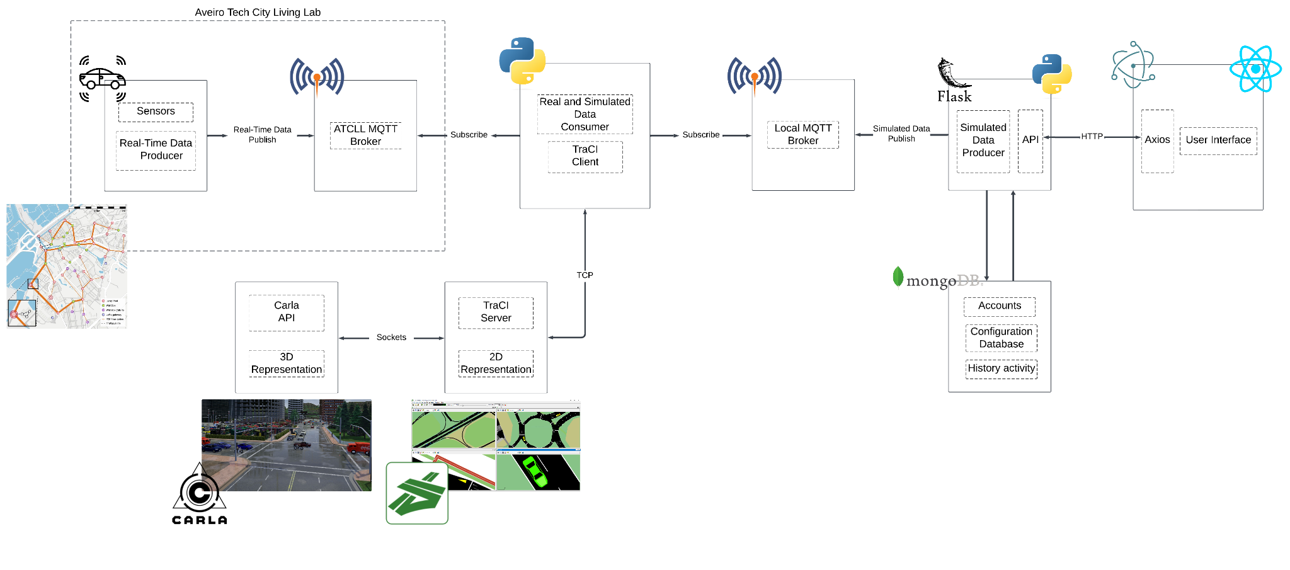
ARCHITECTURE
Notes:
Adicionar bloco maior máquina isolada com softwares (carla SUmo) e uma especie de api (permite que alguém faça post e gere o que precisamos de forma a que fique mais protegido)

Slide 10

04
WORK DONE

Slide 11
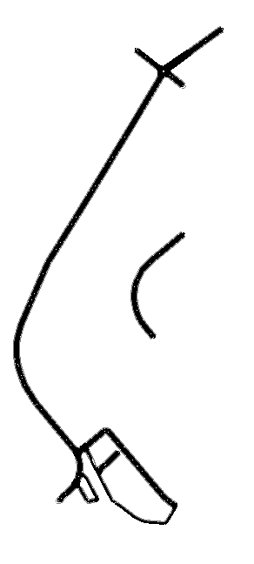
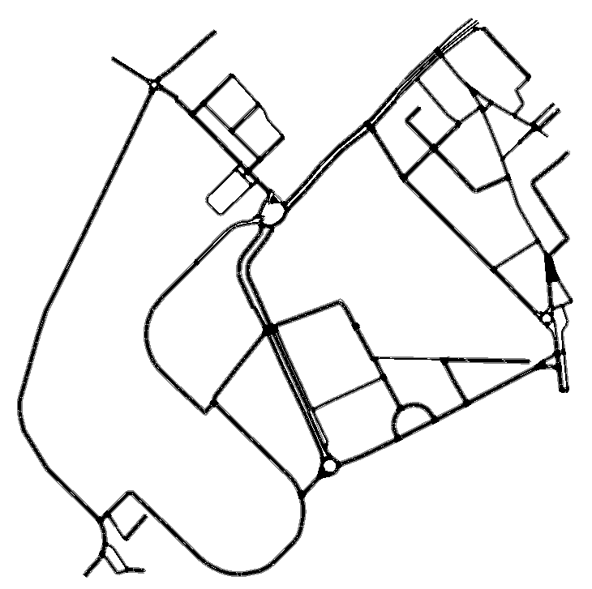


MAP GENERATION
MAP GENERATION
(STEP BY STEP)
MAP EVOLUTION
.osm export (https://www.openstreetmap.org)
Map cleaning with JOSM
Creation of the header with georeferencing for the .xodr *
Creation of the .xodr from .osm *
From .xodr create the .net.xml file
Imagem do mapa antigo
Imagem do mapa novo
.net.xml
.xodr

Slide 12
EVOLUTION OF THE COVERAGE AREA
MAP EVOLUTION

Slide 13
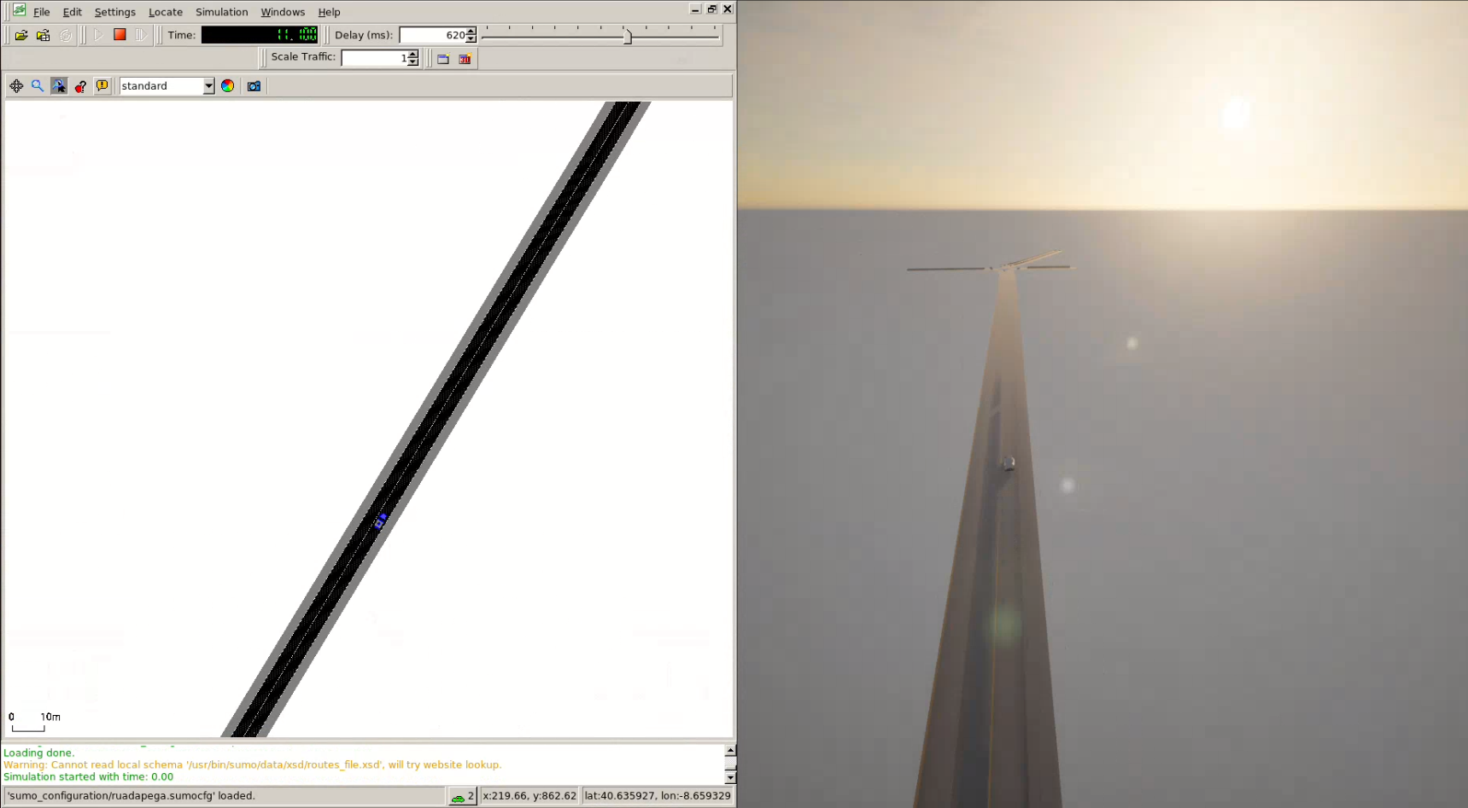
SUMO / CARLA INTEGRATION
Notes:
Adicionar bloco maior máquina isolada com softwares (carla SUmo) e uma especie de api (permite que alguém faça post e gere o que precisamos de forma a que fique mais protegido)

Slide 14

INTEGRATION WITH THE INTERFACE
Simulation of a car with a specific route
User management
Addition of massively simulated data

Slide 15
USER MANAGEMENT
Allow the User to create an account in order to make simulations
Users can Login anytime they wish to make a new simulation

Slide 16
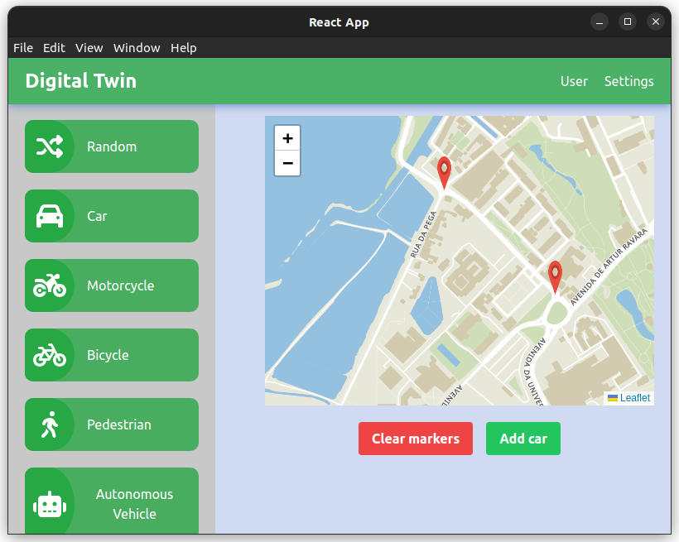
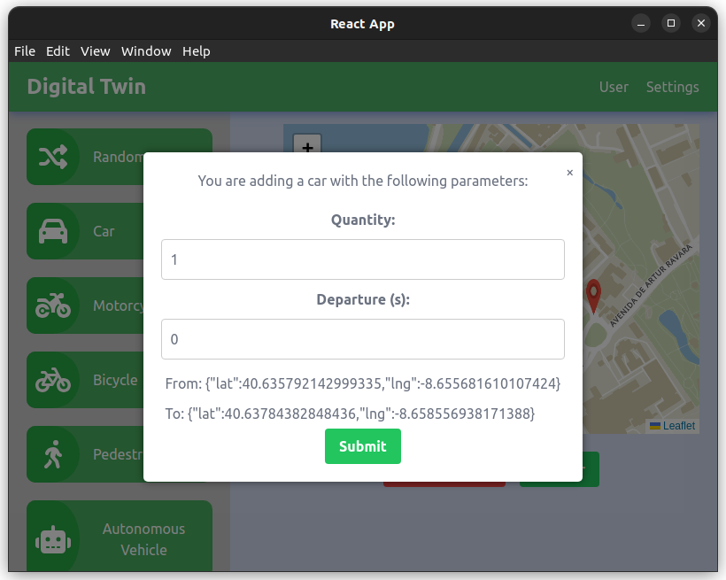
SIMULATED DATA PRODUCTION
Interface under development

Slide 17
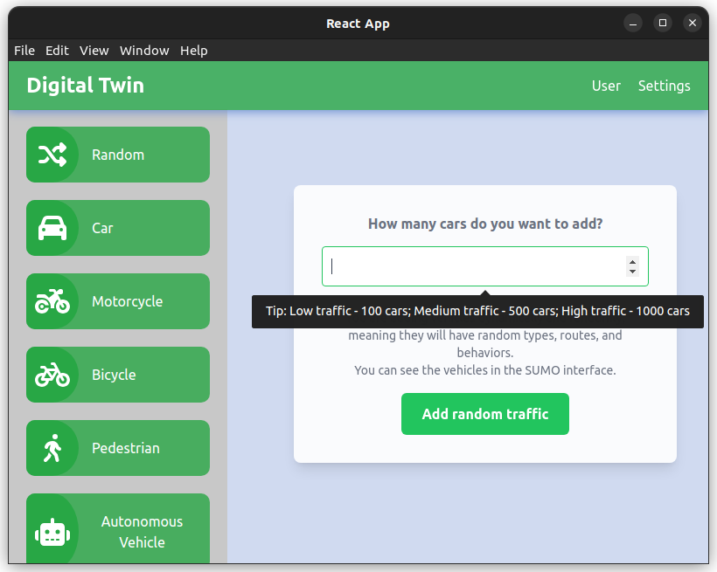
ADDITION OF MASSIVELY SIMULATED DATA

Slide 18
05
PROTOTYPE / DEMO

Slide 19
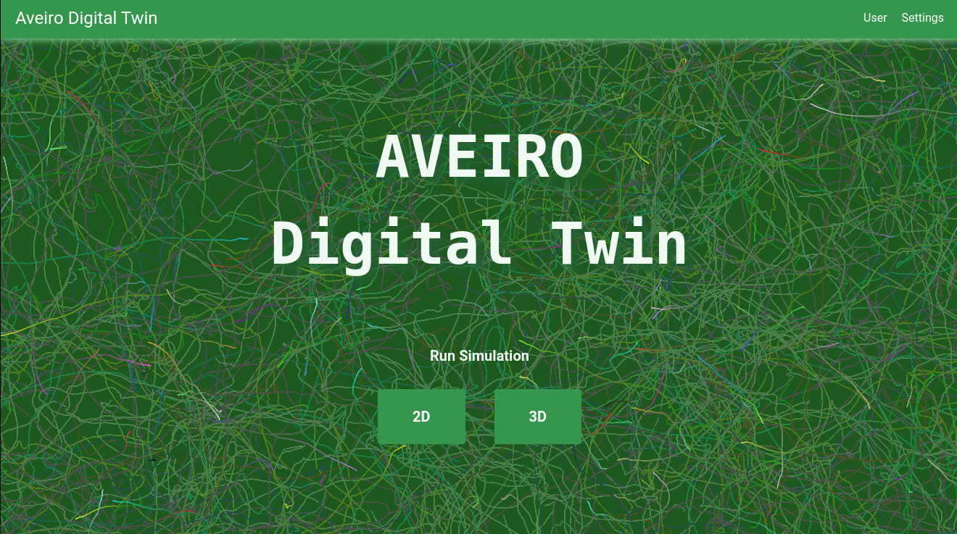

PROTOTYPE / DEMO
Notes:
Adicionar bloco maior máquina isolada com softwares (carla SUmo) e uma especie de api (permite que alguém faça post e gere o que precisamos de forma a que fique mais protegido)

Slide 20
06
FUTURE WORK
Notes:
Integração AUTOWARE( veiculos autonomos) (+ imagem) --- explicar
Integrar simulação dos dados reais com os simulados
Containers e problemas relacionados
Colisoes (ja sabemos como ambos interagem temos dados reais/temos dados simulados. Agora temos conflitos como os vamos resolver?)
Integrate simulation of real data with simulated ones
Containers and related issues
Collisions (we already know how both interact, we have real data/we have simulated data.

Slide 21
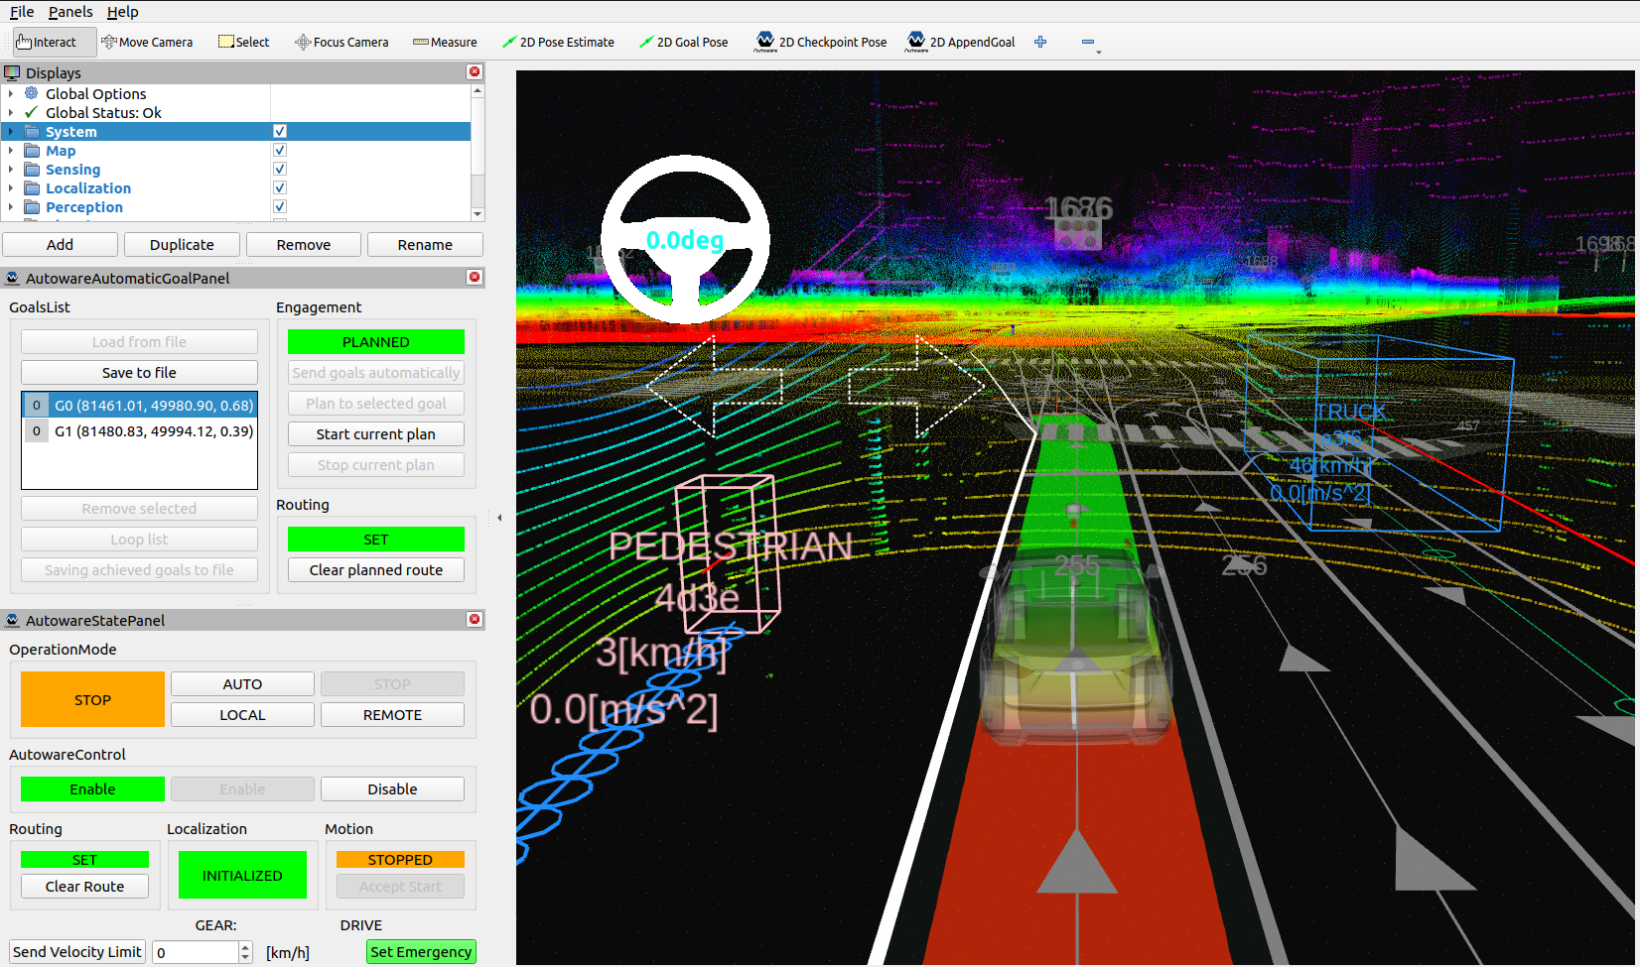
INTEGRATION WITH THE INTERFACE
2
1
3
4
Integration AUTOWARE (Autonomous Vehicles)
Integrating real data simulation with
simulated ones
Service containers
Collisions

Slide 22
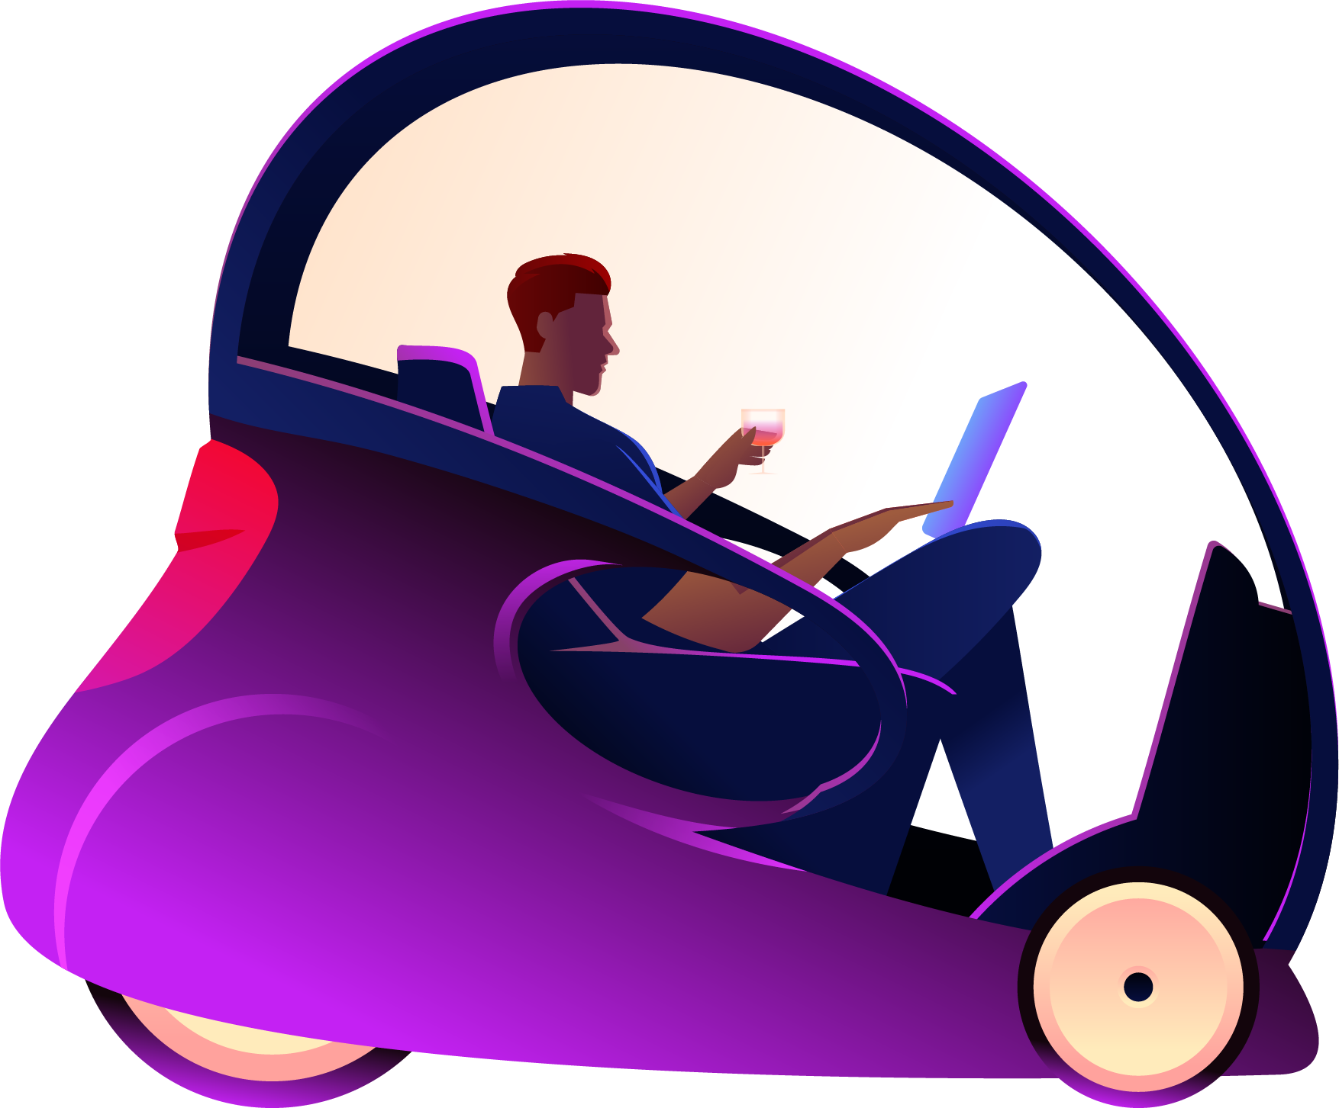
Thanks!
Do you have any questions?

